Slide 1
Accessibility in Libraries – Practical Example from the Library of Pfennigparade Foundation in Munich
Helmut Obst
Pfennigparade Foundation
Head of Library
May 12, 2025

Slide 2
Introduction
Physical Accessibility
Media Collection and Digital Services
Special Features of the Service
Inclusive Library Work with Cooperations
Summary and Exchange

Slide 3
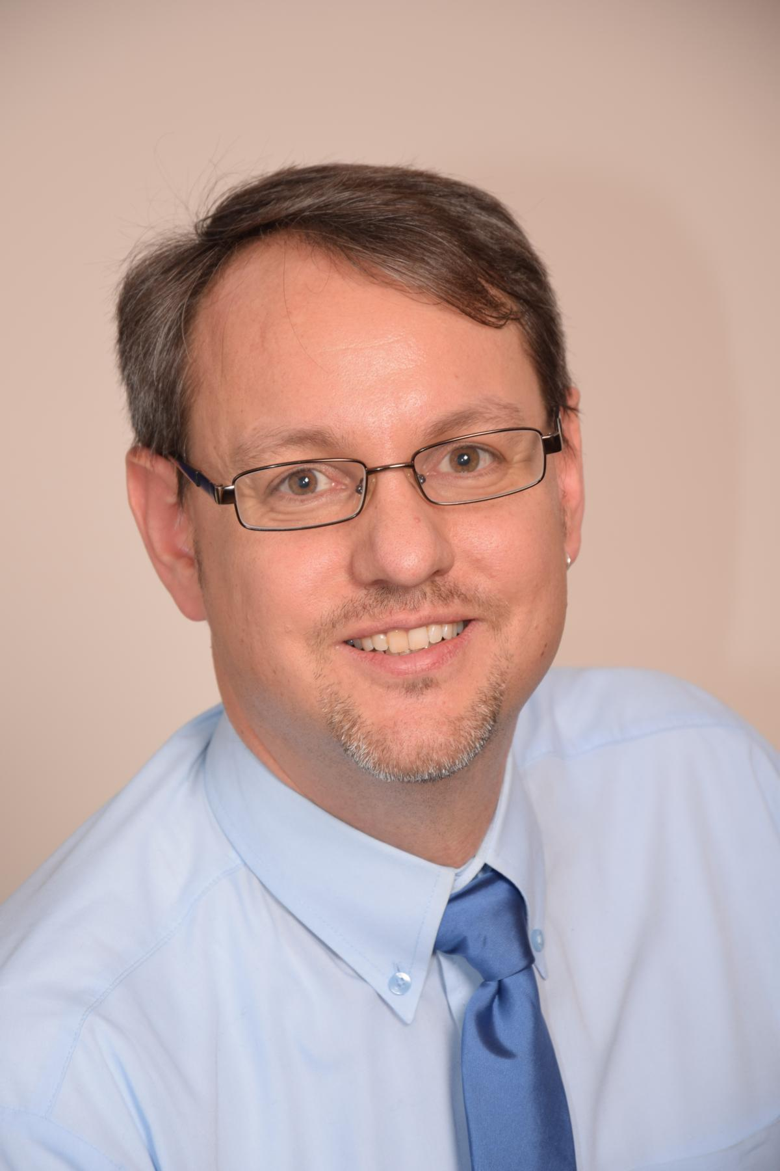




Introduction
Helmut Obst, Head of Library
Library Science for Public Libraries at Stuttgart Media University (Germany)
1999-2003
Head of Library at Pfennigparade Foundation since 2003
Extra-occupational Masterstudies of Library and Information Science at Humboldt-University of Berlin (Germany) 2010-2012
Editing the book 'Media at the Margins'
2024

Slide 4
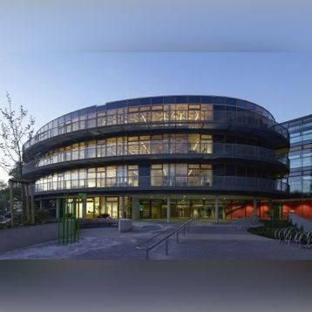
Introduction
Pfennigparade Foundation:
founded in 1952
living, learning and working for physically handicapped
2,500 disabled and non-disabled employees
cooperation with big companies like automobile manufacturer BMW

Slide 5
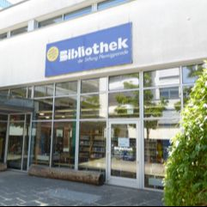
Introduction
Key Figures on the Library
of Pfennigparade Foundation:
founded in 1996
public library and school library
14,500 media
staff: director + voluntary service worker
lending for free
integrative conception

Slide 6
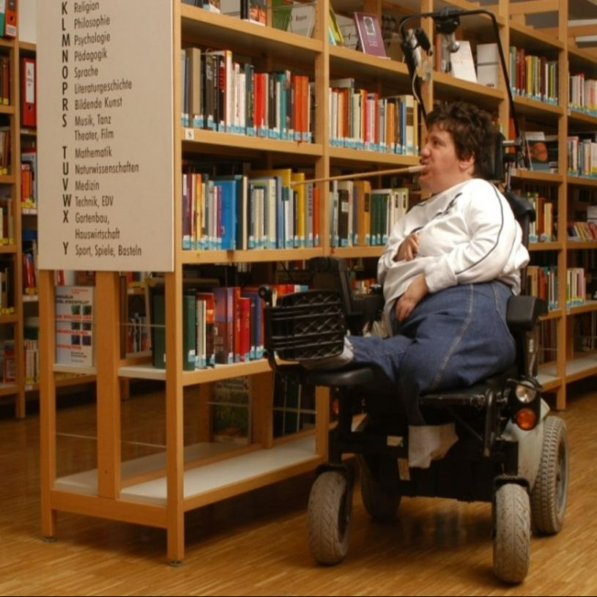
Introduction
Main Target Group of the Library:
People with (physical) disabilities

Slide 7
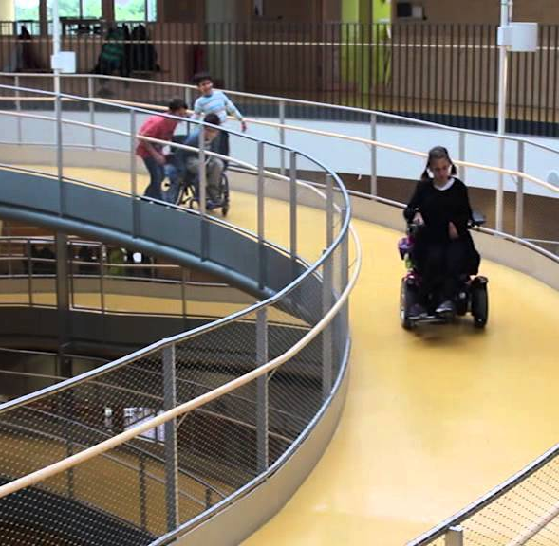
Physical Accessibility
Access to the Library:
automatic doors, large elevators, avoidance of steps and thresholds, ramps, wheelchair-accessible restrooms

Slide 8
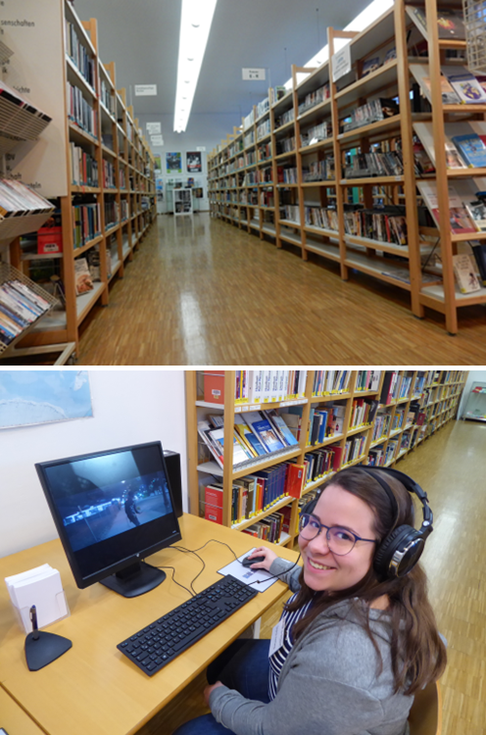
Physical Accessibility
Design of Library Spaces:
wide aisles between shelves, wheelchair-accessible counter, height-adjustable computer workstations

Slide 9
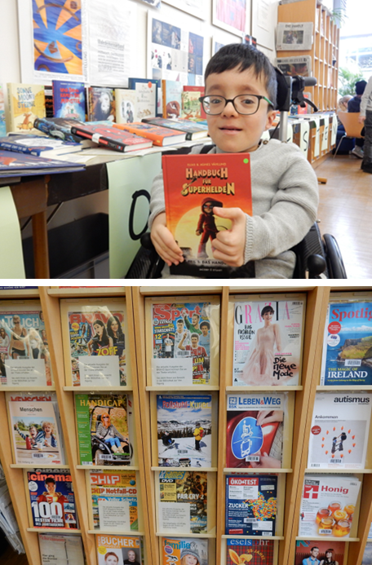
Media Collection and Digital Services
Media Collection Focused on Disability and Inclusion:
non-fiction books, novels, children’s and young adult books, films, magazine collection

Slide 10

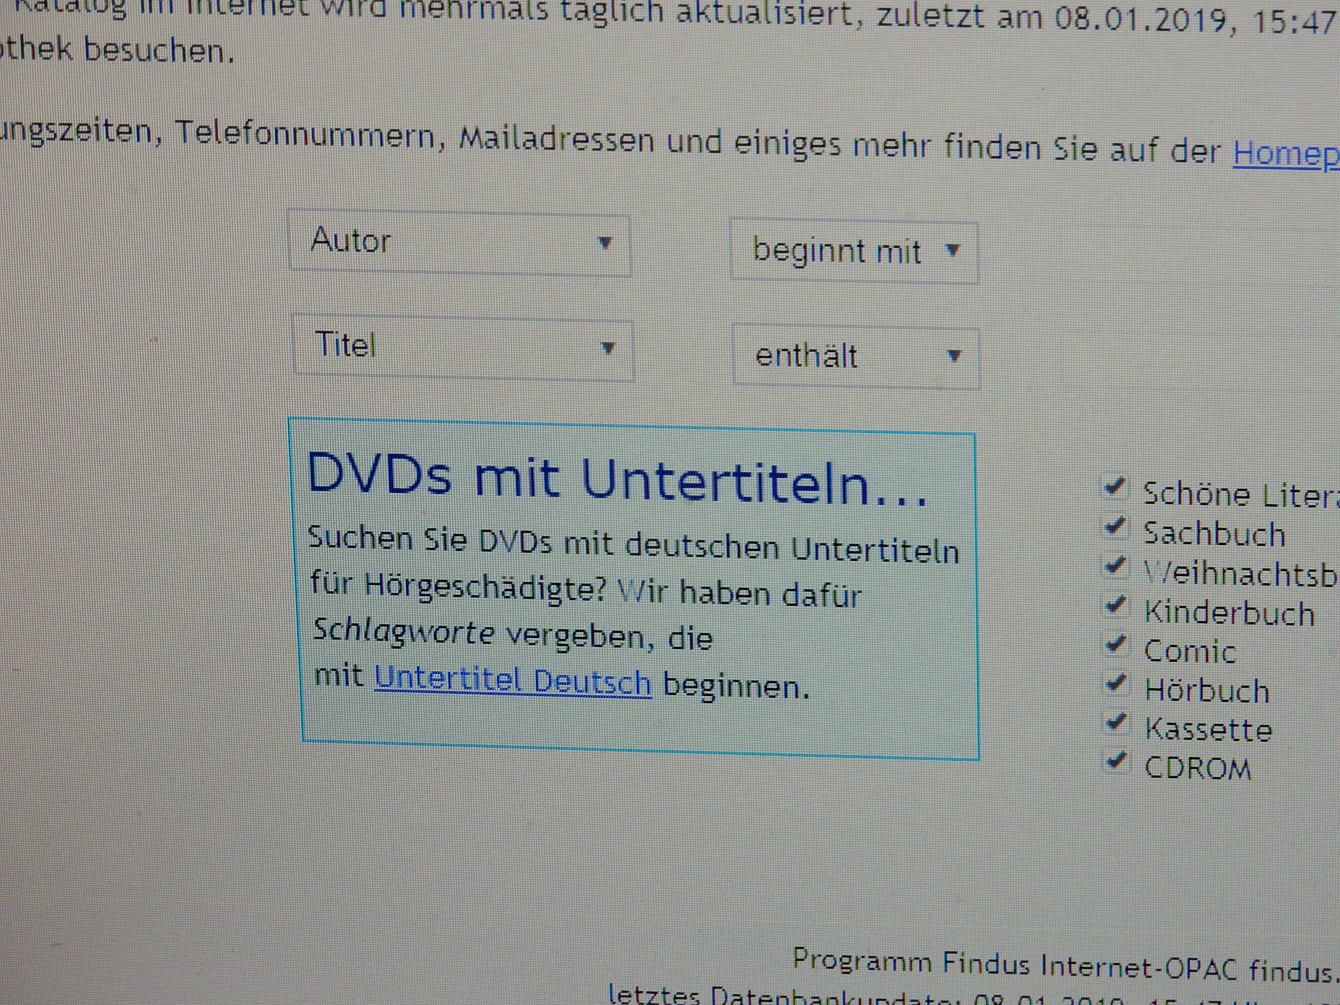
Media Collection and Digital Services
Digital Service:
borrowing of e-media via the Onleihe network BiblioLoad,
search criteria for DVDs with subtitles
www.biblioload.de

Slide 11

Media Collection and Digital Services
Provision of Adaptive Console Controllers for Inclusive Gaming

Slide 12
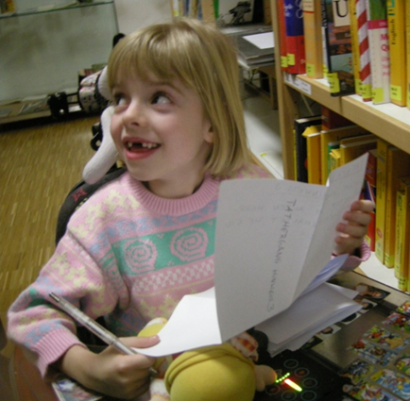
Special Features of the Service
Special Communication with the Target Group:
adjustments for speech difficulties,
content sensitivity in dialogue

Slide 13
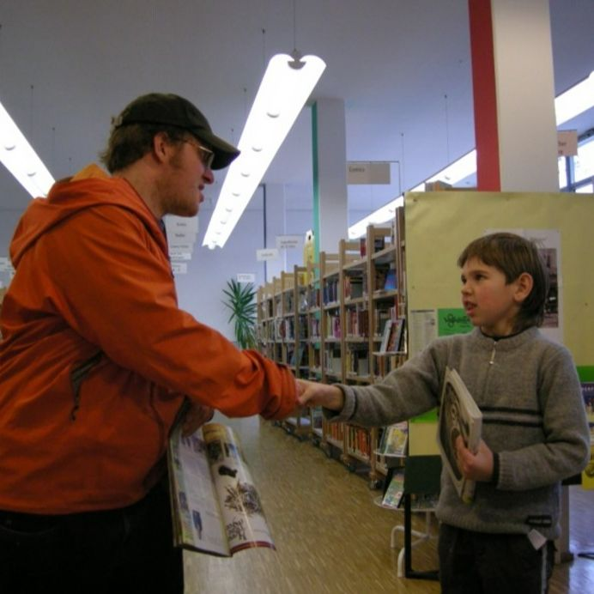
Special Features of the Service
Increased Time Requirements

Slide 14
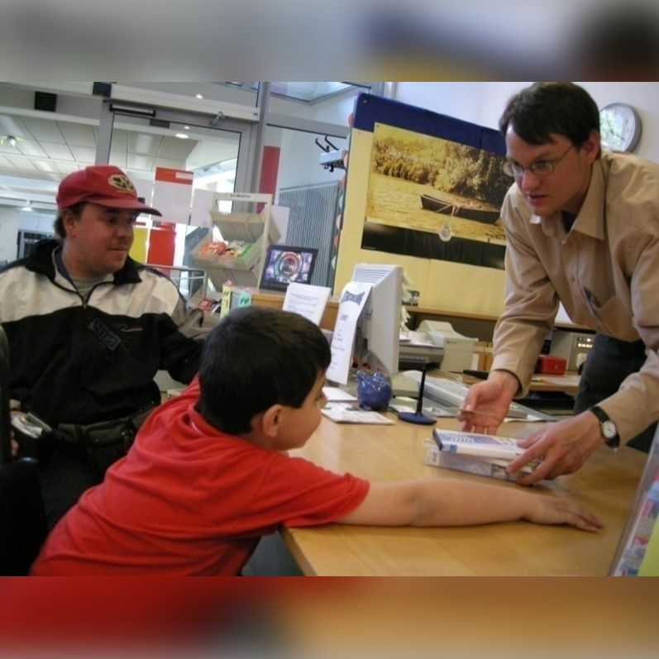
Special Features of the Service
Appropriate Responses and Assistance

Slide 15


Inclusive Library Work with Cooperations
Cooperation with the Bavarian Library for the Blind, Munich
Cooperation with the German Center for Accessible Reading, Leipzig

Slide 16

Summary and Exchange
Practical Experiences: Challenges and Opportunities
Questions and Discussion

Slide 17
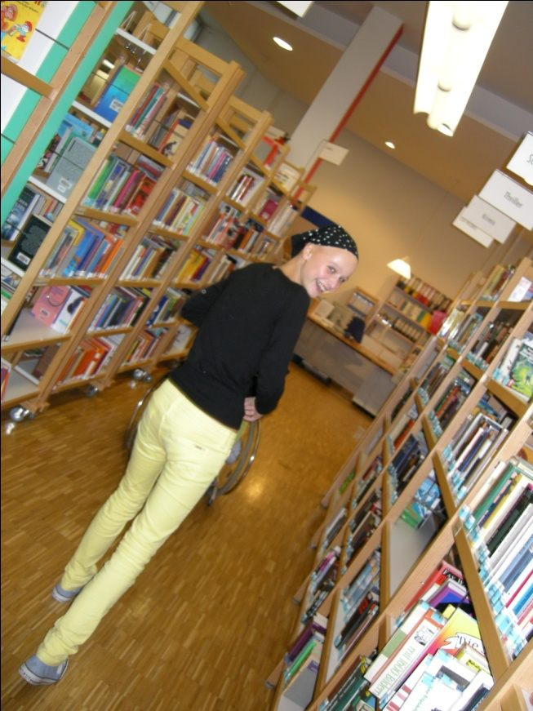

Thank you!
Helmut Obst
Pfennigparade Foundation, Munich (Germany)
bibliothek@pfennigparade.de
www.pfennigparade.de

